Slide 1
Namespace and Autoloading

Slide 2
Learning Objectives
By the end of this week, students will be able to:
Explain the purpose of namespaces in PHP.
Create and use namespaces to organize code.
Understand how autoloading works in PHP.
Use spl_autoload_register() to automatically load classes.

Slide 3
What is a Namespace?
-A namespace is like a folder or label for your classes.
-It prevents name conflicts between classes with the same name.
-Think of it like File > Folder > Class.

Slide 4
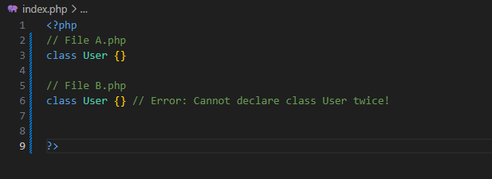
Example Without Namespace

Slide 5
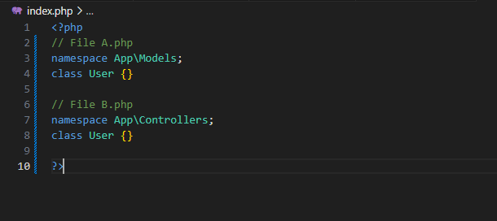
Example With Namespace
Notes:
Namespace = "folder name"
Class = "file inside folder"

Slide 6
What is Autoloading?

